Slide 1
AUGMENTED REALITY IN ADVERTISING
TEAM 12
SAMHITHA TUMMANAPALLI
SWATI SINGH
ZENAT TARIQ
SAYED KHUSHAL SHAH

Slide 2

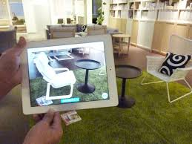
PURPOSE
Many companies face the downfall due to various reasons. One of them could be the lack of advertising of their products
This project is aimed at helping such companies improve their business with the latest advertising strategies such as augmented reality.

Slide 3






TECHNOLOGIES
Vuforia
Clarifai API
HTML
CSS
JAVA SCRIPT
IONIC
Unity
C#

Slide 4

AUGMENTED REALITY FEATURES
HYBRID/CROSS PLATFORM APP
DISPLAYS IMAGE IN 3D
MARKER SCANS
SCALABLE TO ADD AS MANY OBJECTS AS NEEDED
MULTIPLE OBJECT SELECTION DYNAMICALLY
USER CAN ZOOM AND ROTATE THE OBJECTS
DROP DOWN MENU TO SELECT DESIRED FURNITURE TYPE
MARKER CAN BE SCANNED IN THE DESIRED SPACE

Slide 5

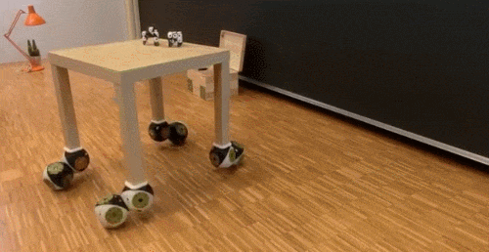


AUDIO FEATURES
EXTRACT FEATURES OF OBJECT
SHOW ACCURACY
MOVE OBJECT AND PLACE IT AT DESIRE PLACE
CHANGE COLOR OF THE OBJECT THROUGH VOICE
PLAY MUSIC ACCORDING TO THE COLOR OF OBJECT
SCALIBITY FOR ADDING MORE OBJECTS

Slide 6

ISSUES
Limited access to free objects for modelling in 3D

Slide 7

FUTURE SCOPE
Can be used in E-commerce
Saving options can be incorporated
Dynamic display of the whole room furniture instead of a single object at a time
Changing color of whole furniture according to one’s choice and playing music enhance the sale rate

Slide 8
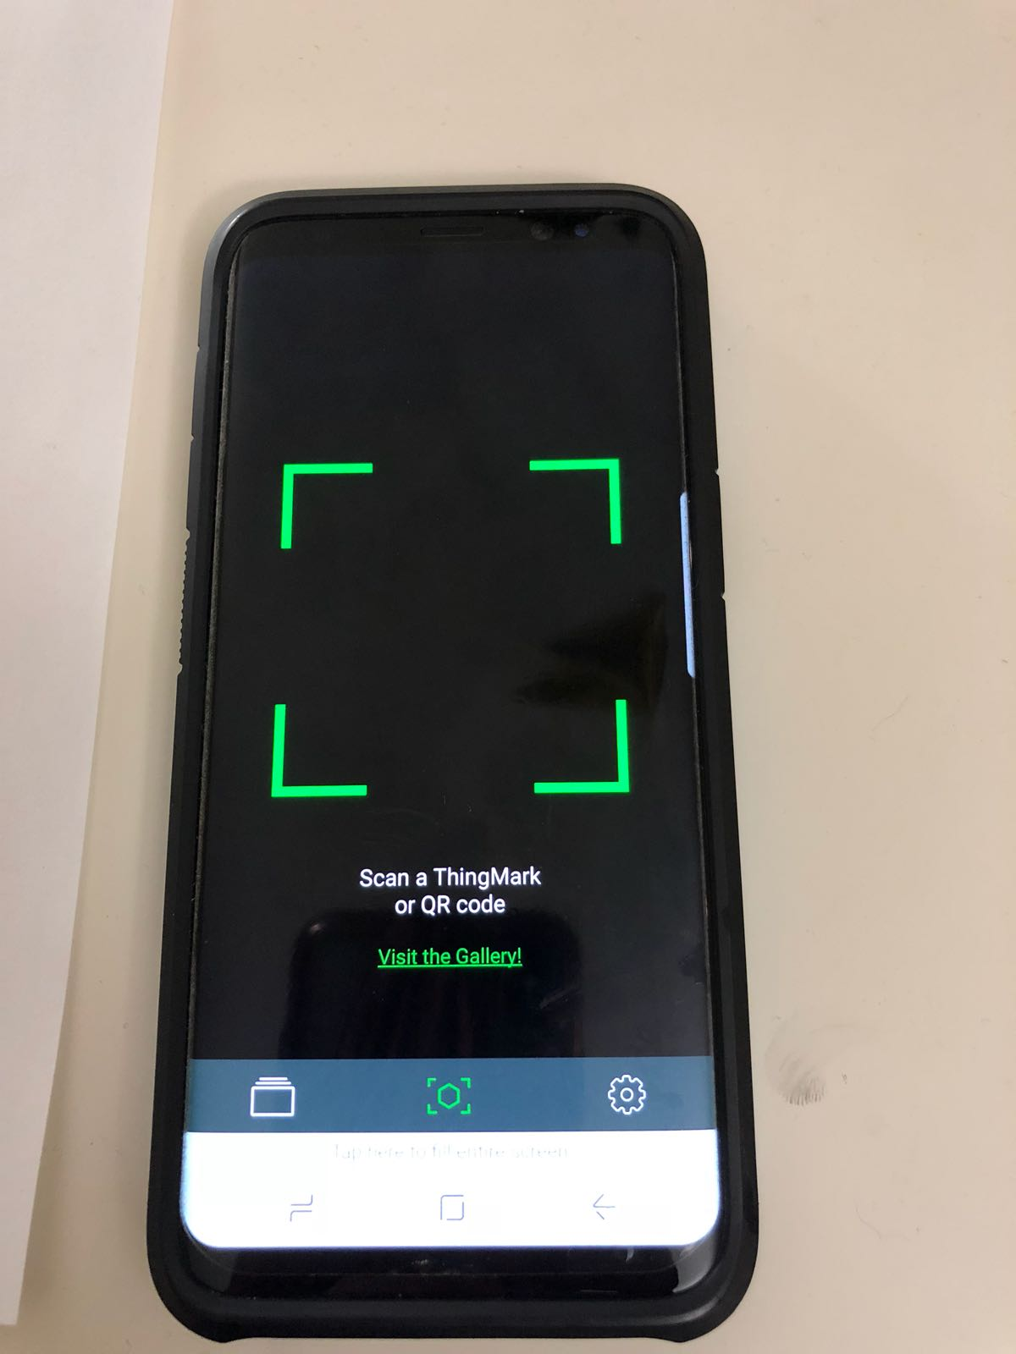
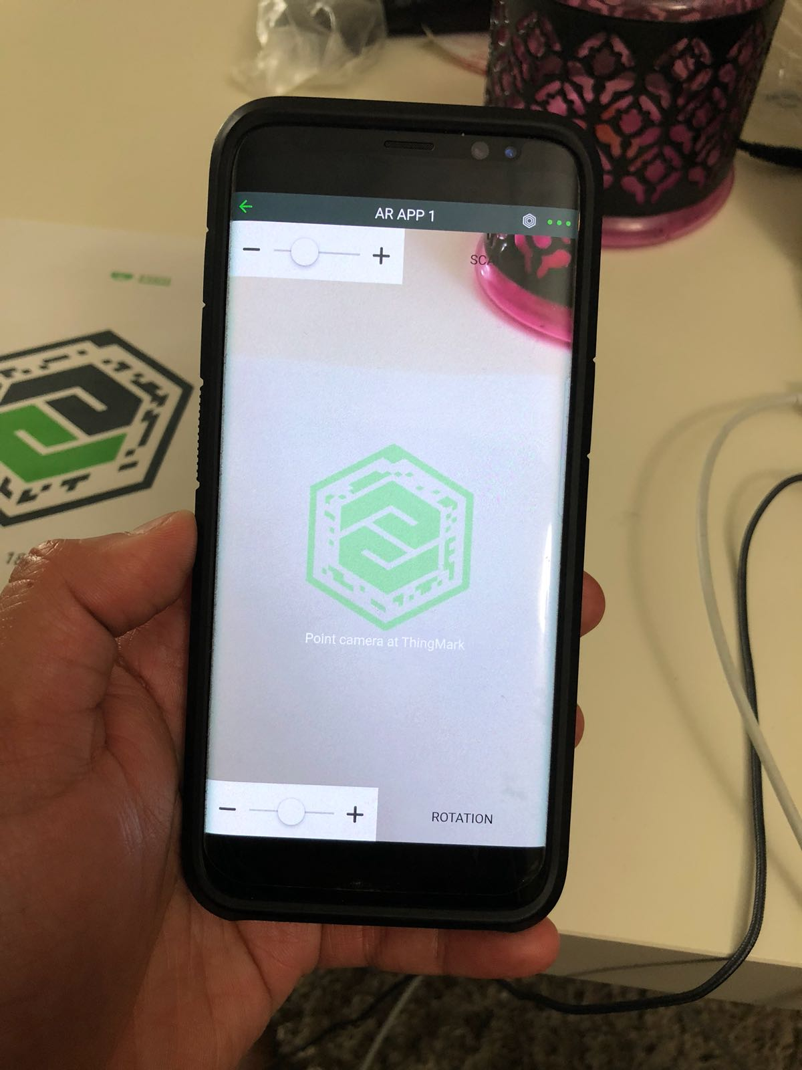
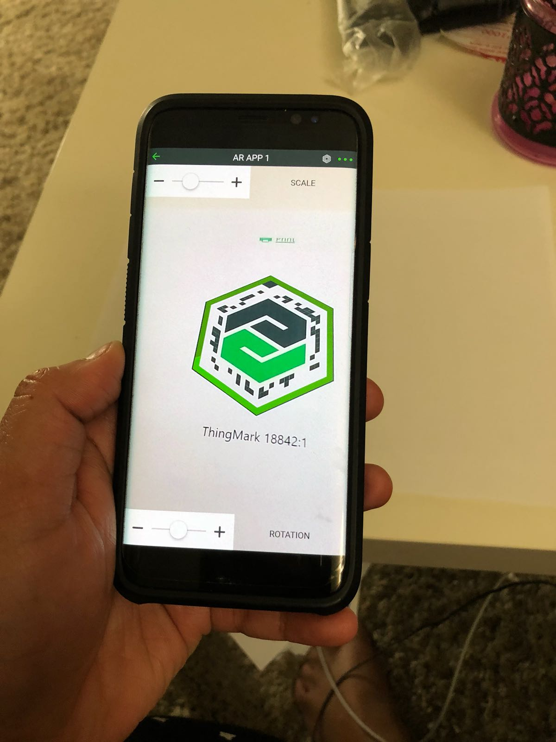

Slide 9
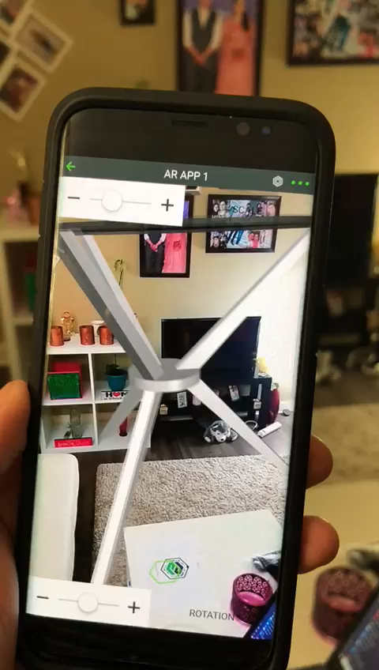
Video links : https://youtu.be/hJcRfW0Xlzs https://www.youtube.com/watch?v=PFVzxPHgx1E&t=1s

Slide 10
REFERENCES
https://library.vuforia.com/articles/Training/getting-started-with-vuforia-in-unity.html
https://grabcad.com/library
https://icecreamapps.com/Download-Screen-Recorder/
https://www.ptc.com/en/about

Slide 11

Questions ??

